Slide 1
Detecting Land Use Change in Kern County CA
Michelle Williams
CYP255 (Urban Informatics and Visualization)

Slide 2
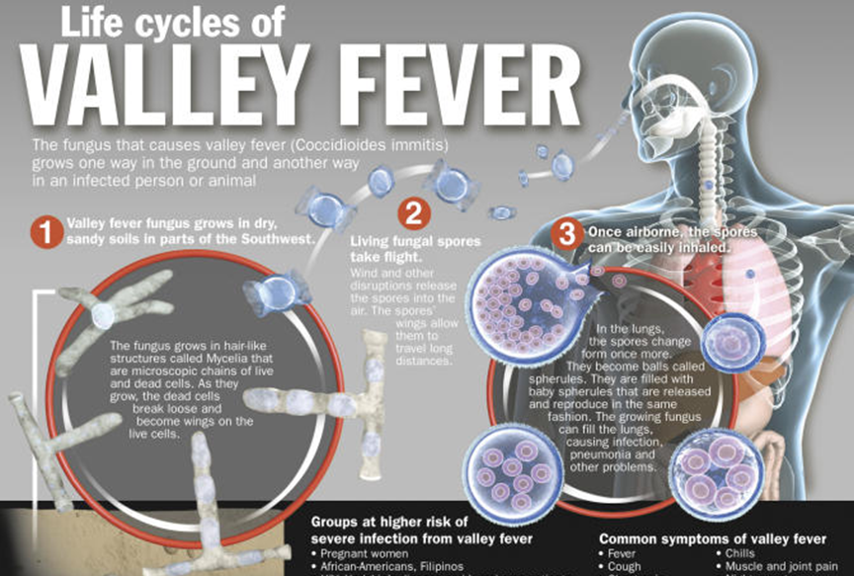
Motivation
Kern County is a hotspot for coccidioidomycosis (Valley Fever), caused by a soil dwelling fungus in the Coccidioides genus
Increases in California since 2000 are not well understood.
Land use and land disturbance may play key roles in fungal growth, proliferation, and spore production.

Slide 3
Objectives
Design a quasi-experimental study to investigate spatial associations between land use changes and Valley Fever human infection data.
Specifically, analyzing association with farmland loss to other uses that may be riskier for fungal growth and development (un-irrigated land uses and disturbed land)
Looking for year-to-year changes of enough area to conduct a statistically valid study

Slide 4
Data Sources
CA Department of Conservation Farmland Mapping and Monitoring Program (FMMP)
10-acre unit of analysis
Based on NAIP remote imagery and landowner surveys, updated every 2 years
Land Use categories include:
**Cl** Confined Animal Agriculture
**D** Urban and Built-Up Land
**G** Grazing Land
**nv** Nonagricultural and Natural Vegetation
**P** Prime Farmland
**R** Rural Residential Land
**S** Farmland of Statewide Importance
**sAC** Semi-Agricultural and Rural Commercial Land
**U** Unique Farmland
**V** Vacant or Disturbed Land
**W** Water

Slide 5
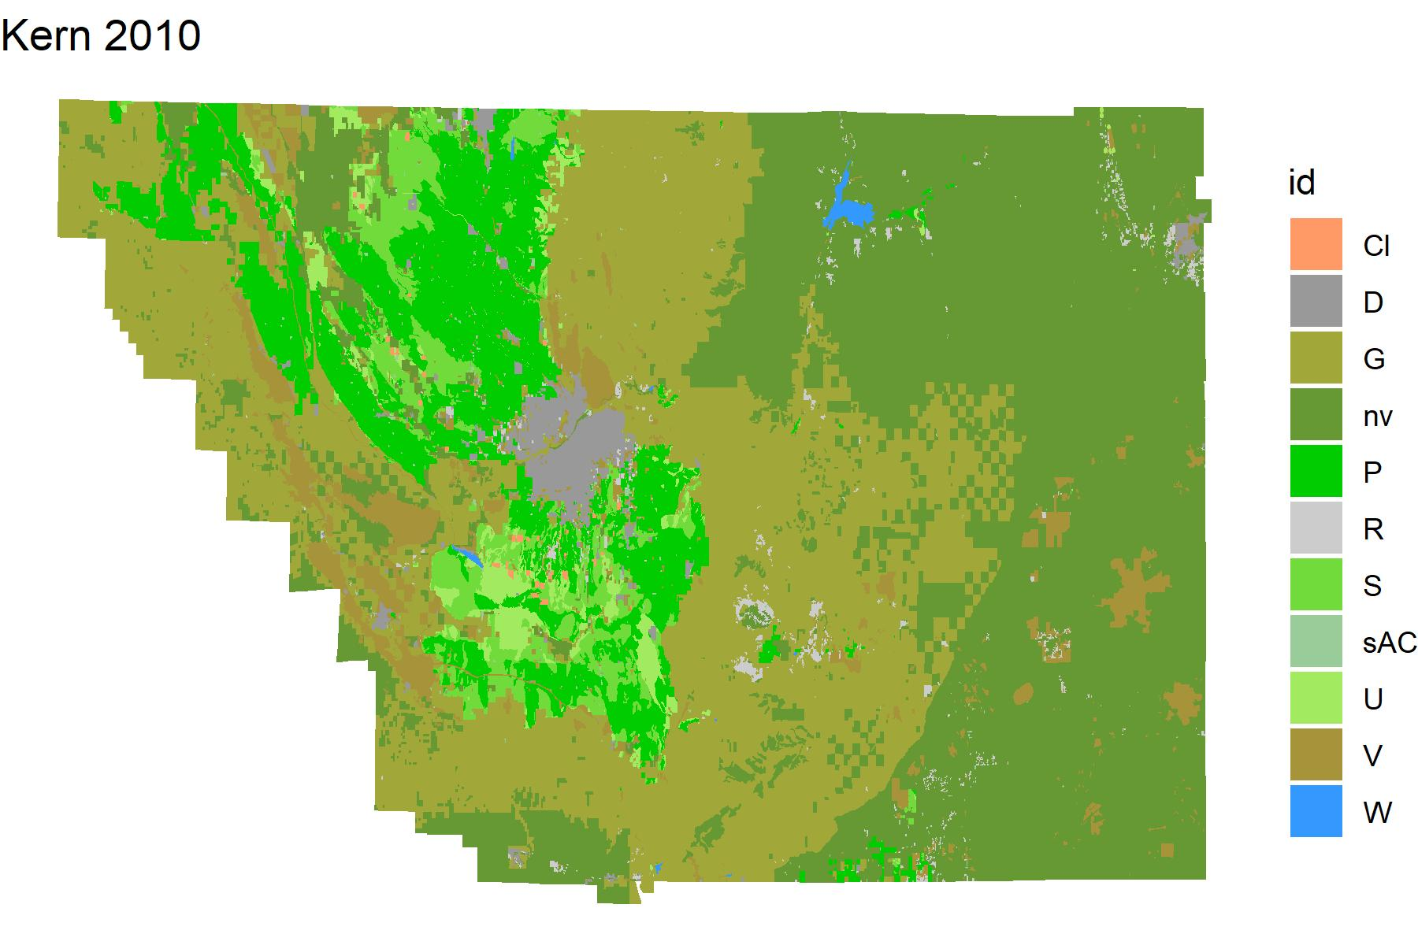

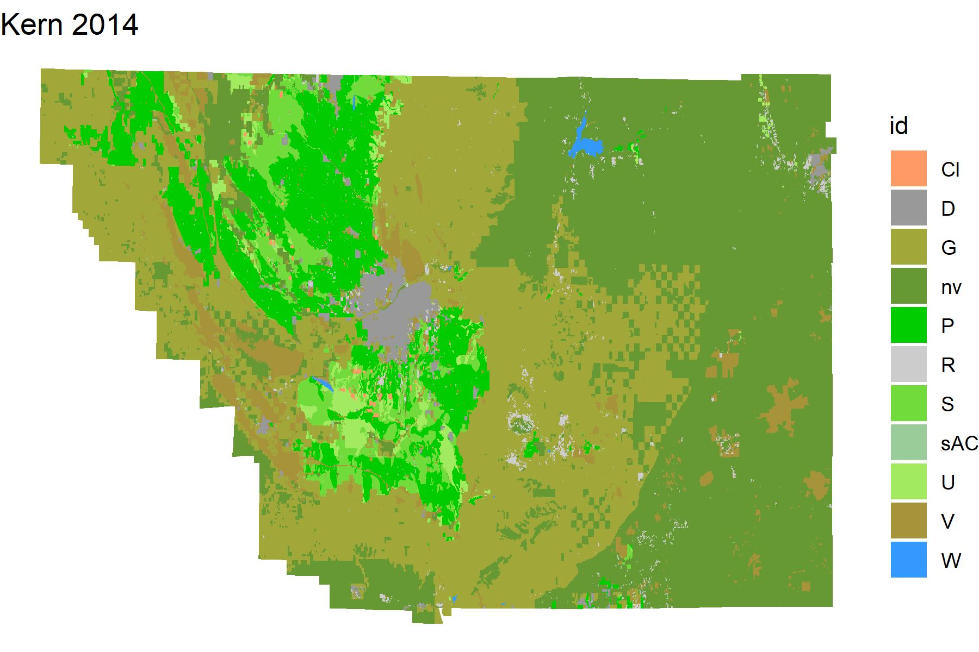



Slide 6
Methods
Rasterize polygons for survey years 2010, 2012, 2014, 2016, and 2018
10 acre scale is equivalent to 40,468.6 m², which amounts to 201 by 201 meter cells in the rasterized land use datasets.
Set farmland land use values to 0
Farmland categories include Prime Farmland (P), Farmland of Statewide Importance (S), and Unique Farmland (U).
Subtract the cells in each raster from the cells in the subsequent raster
2010 – 2012, 2012 – 2014, etc
Values of 0 (0 – 0 = 0) indicate no change in farmland
Negative values indicate change from farmland to another land use (e.g. 0 – 8 = - 8 indicates change from farmland to vacant/disturbed land)
Explore results through summary analysis and visualization

Slide 7
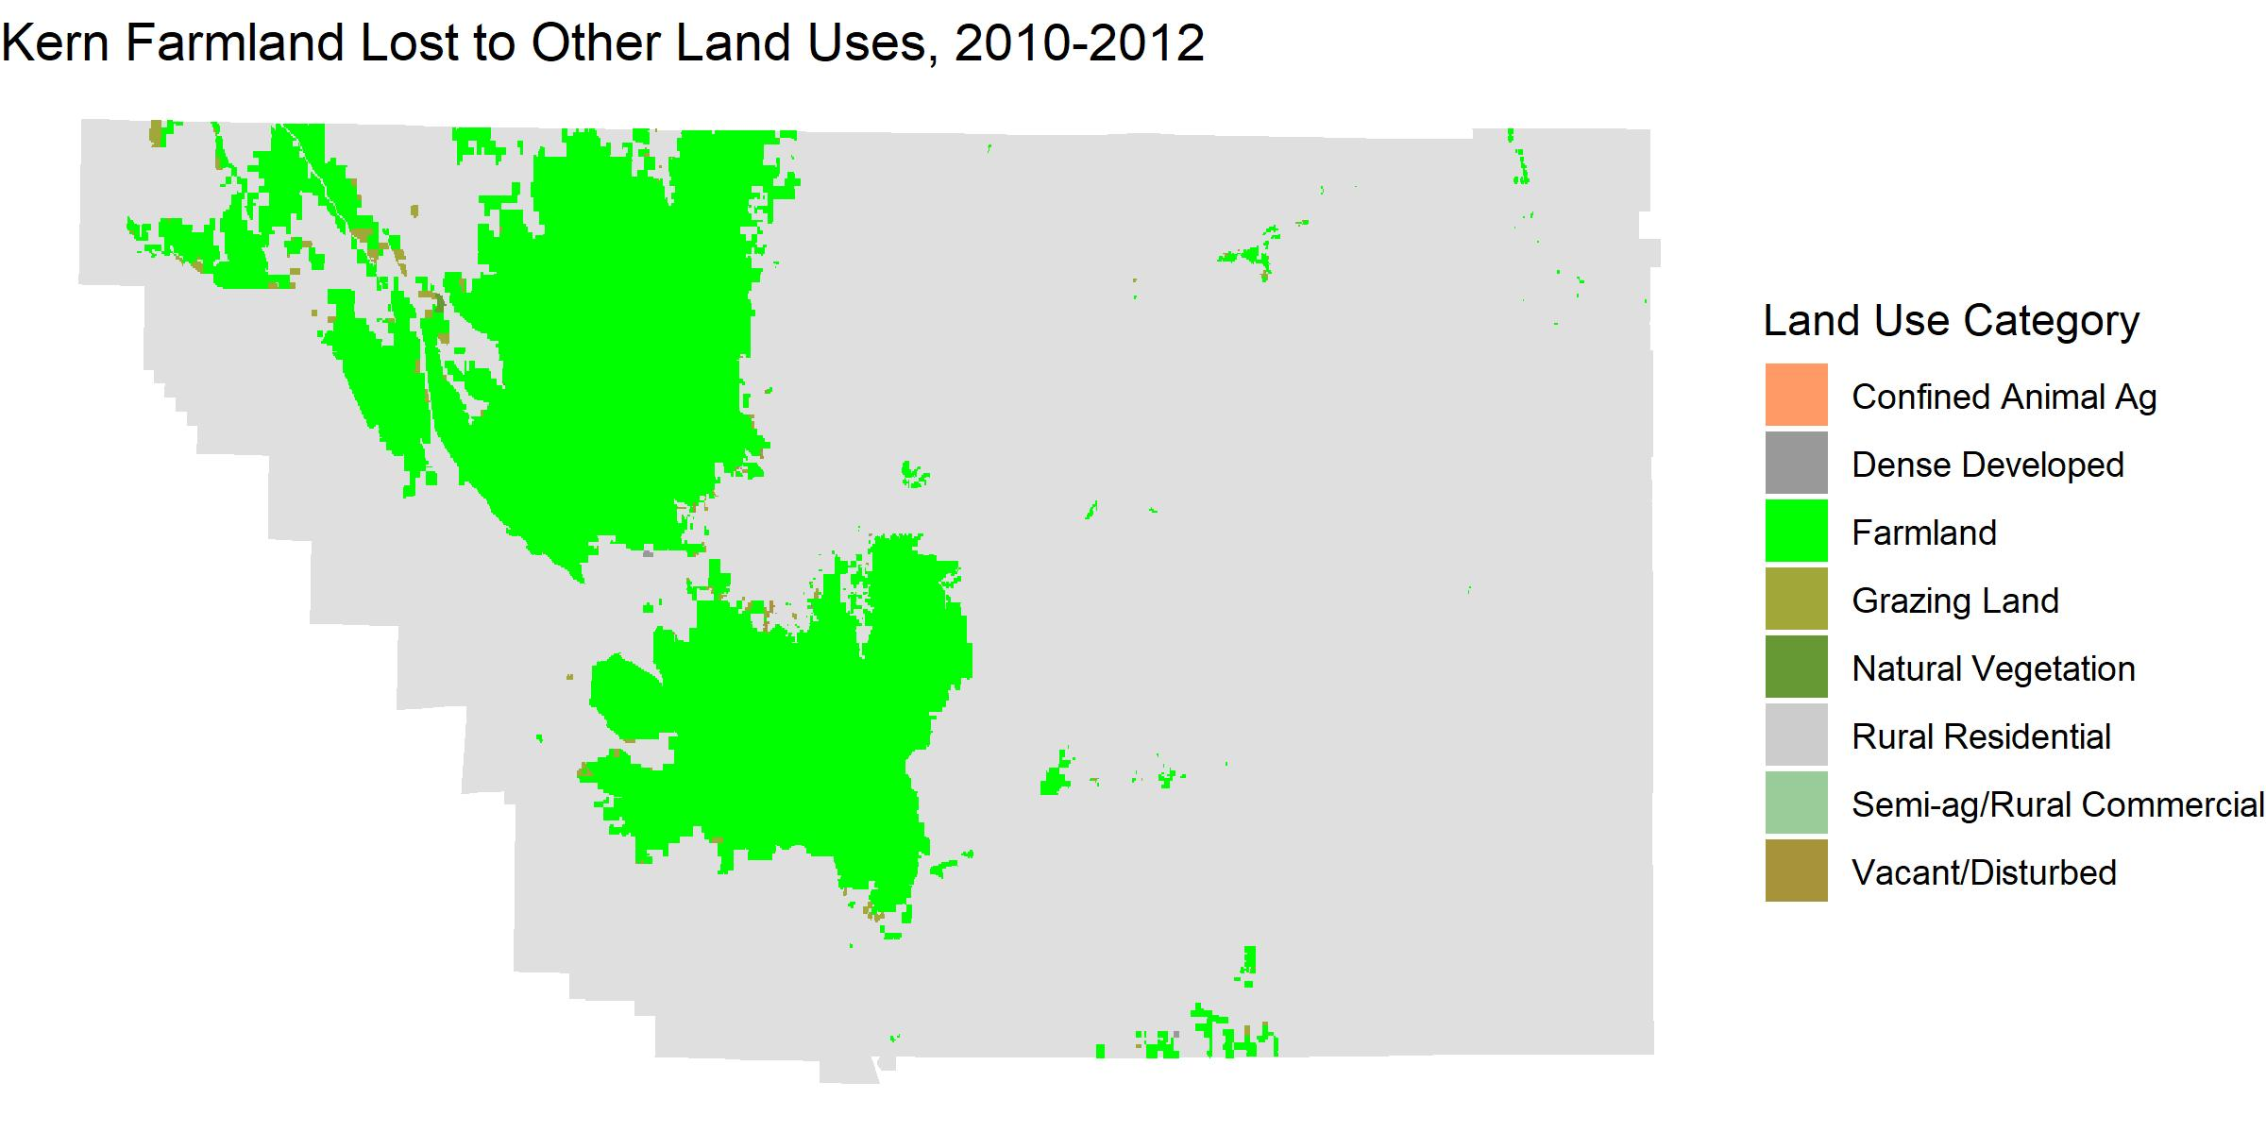
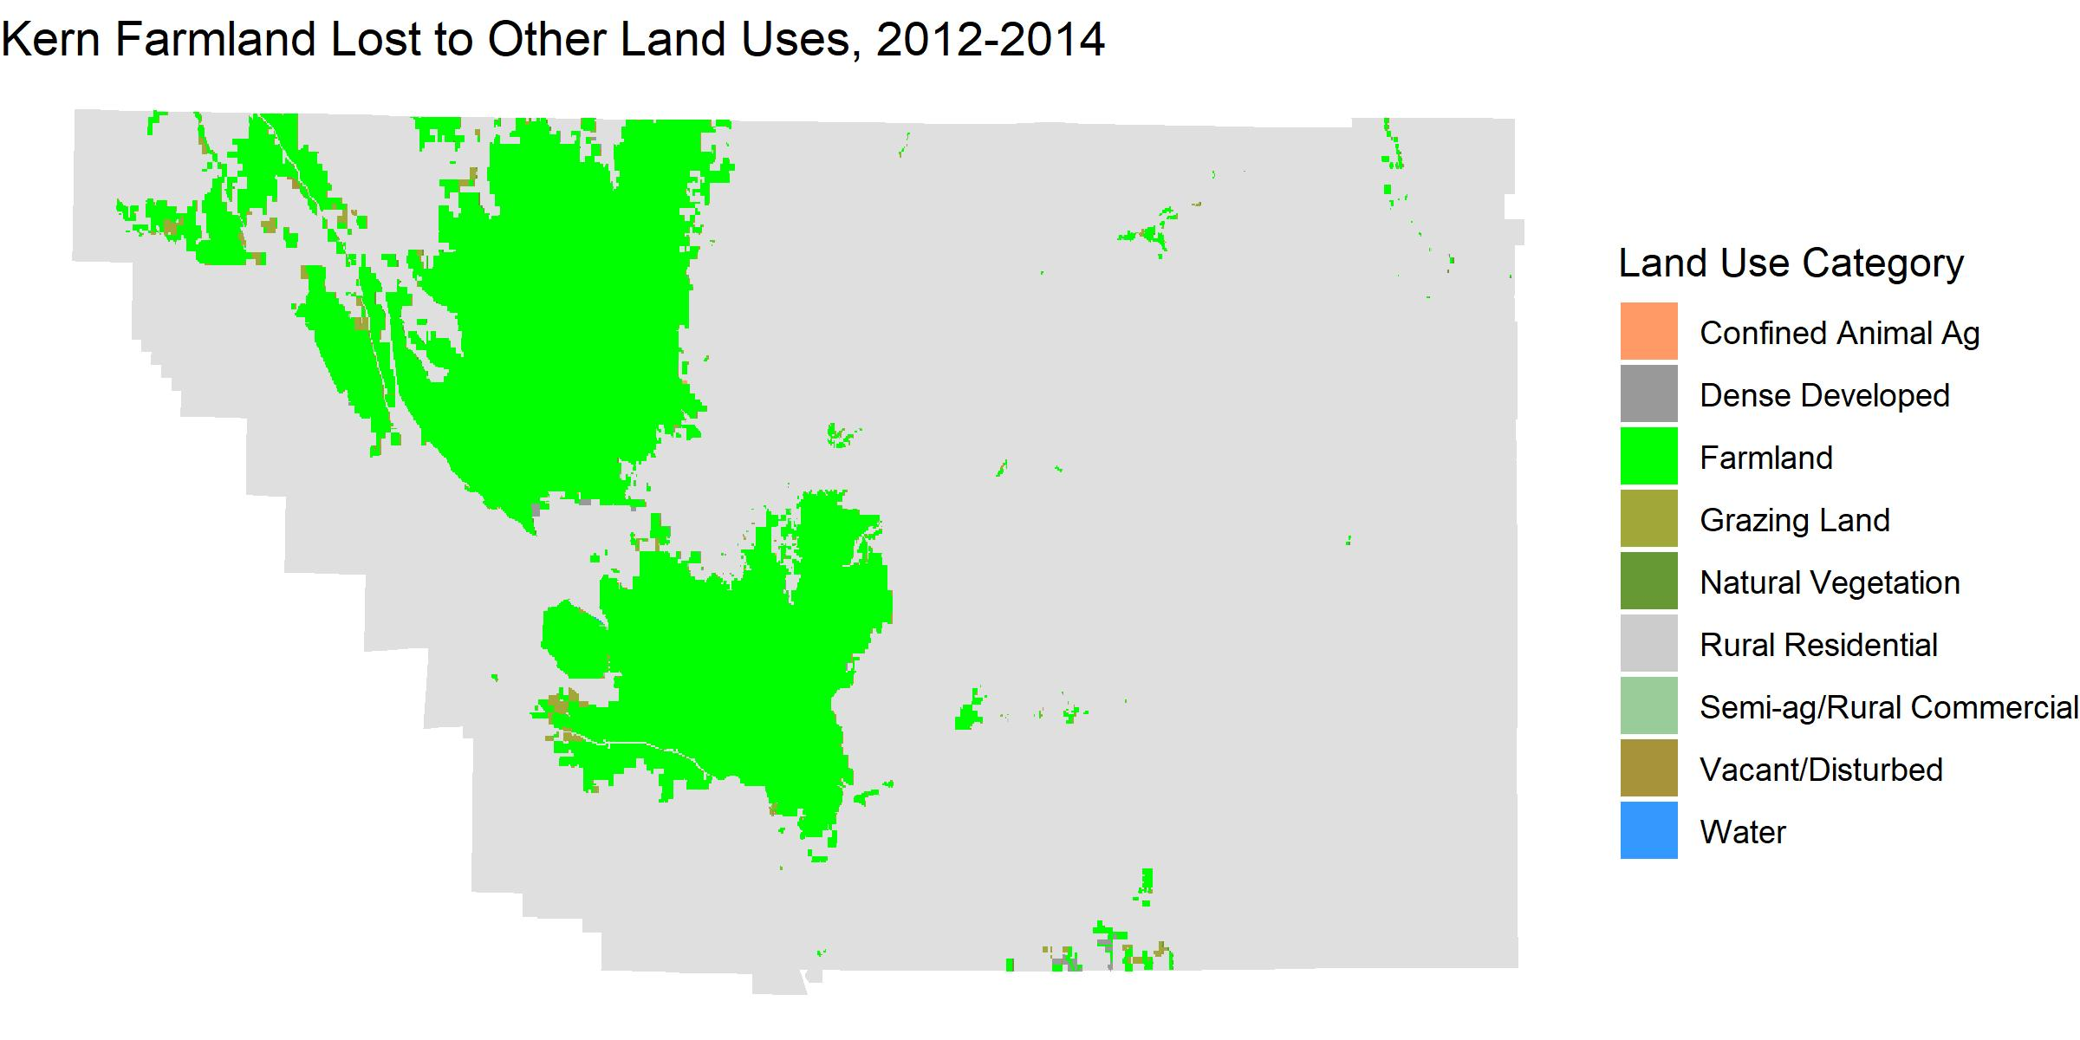
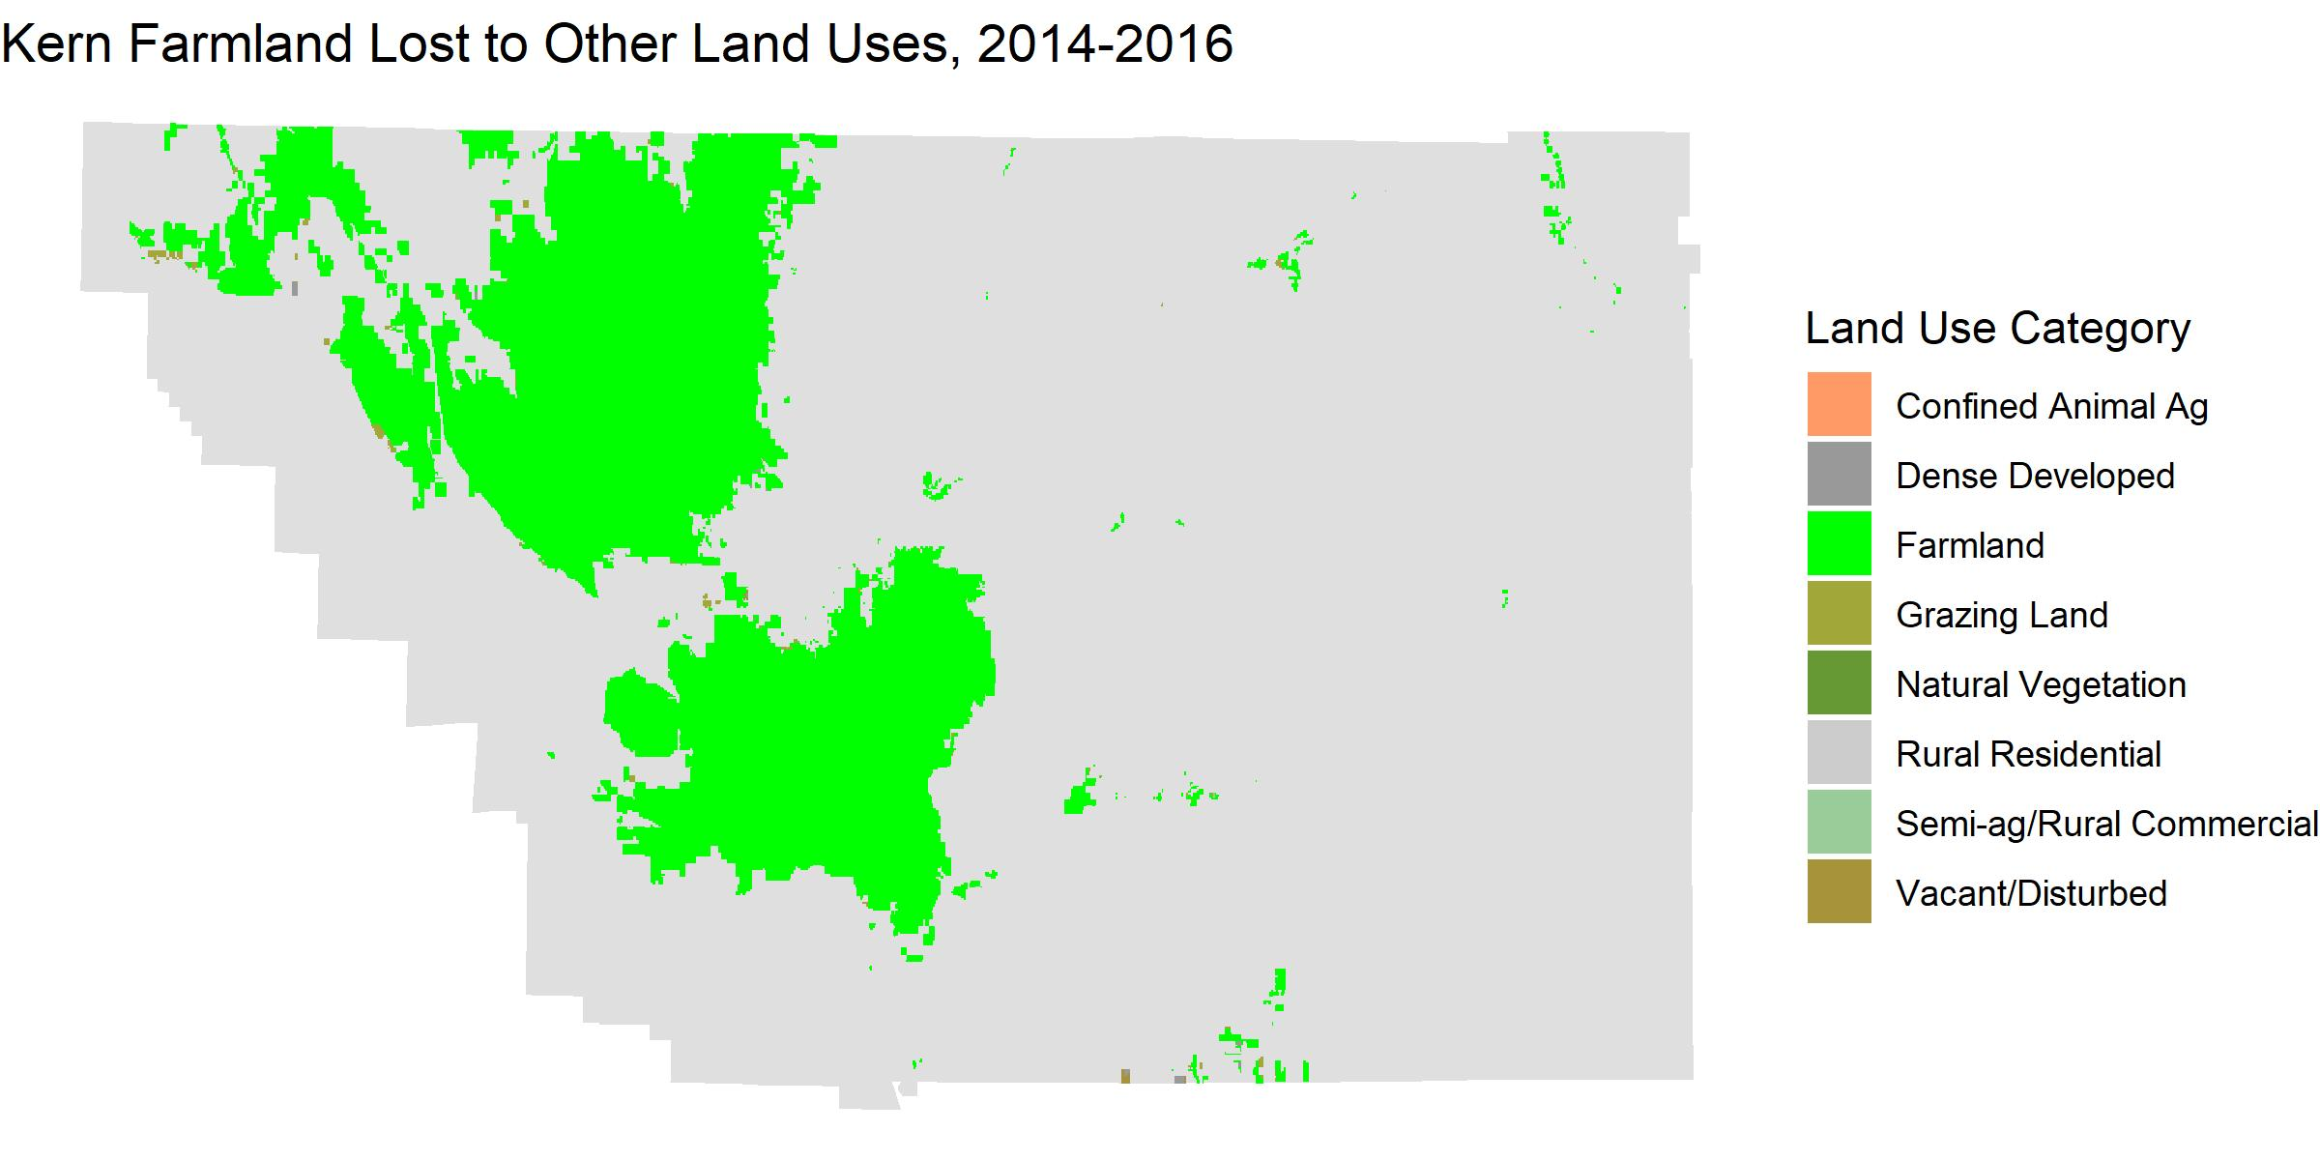
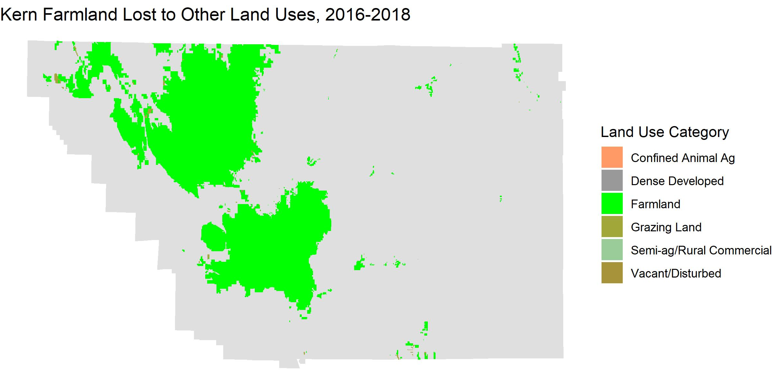
Results
Notes:
Overwhelmingly there was no change in ag land uses across the county

Slide 8
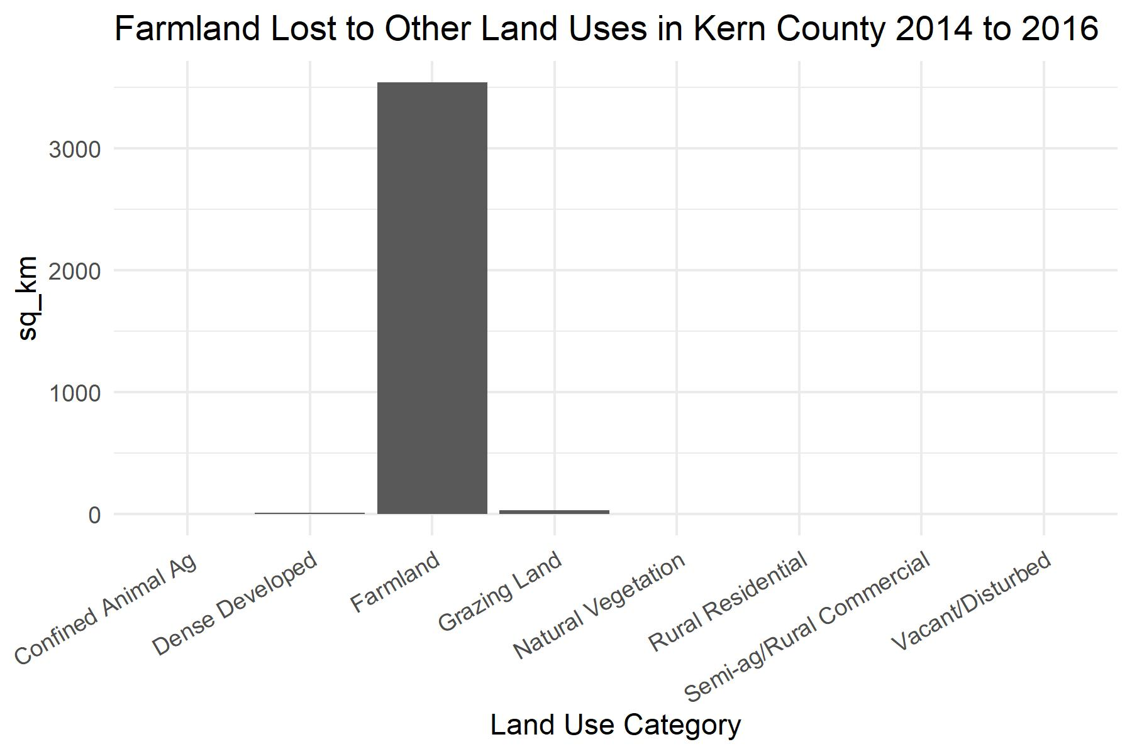
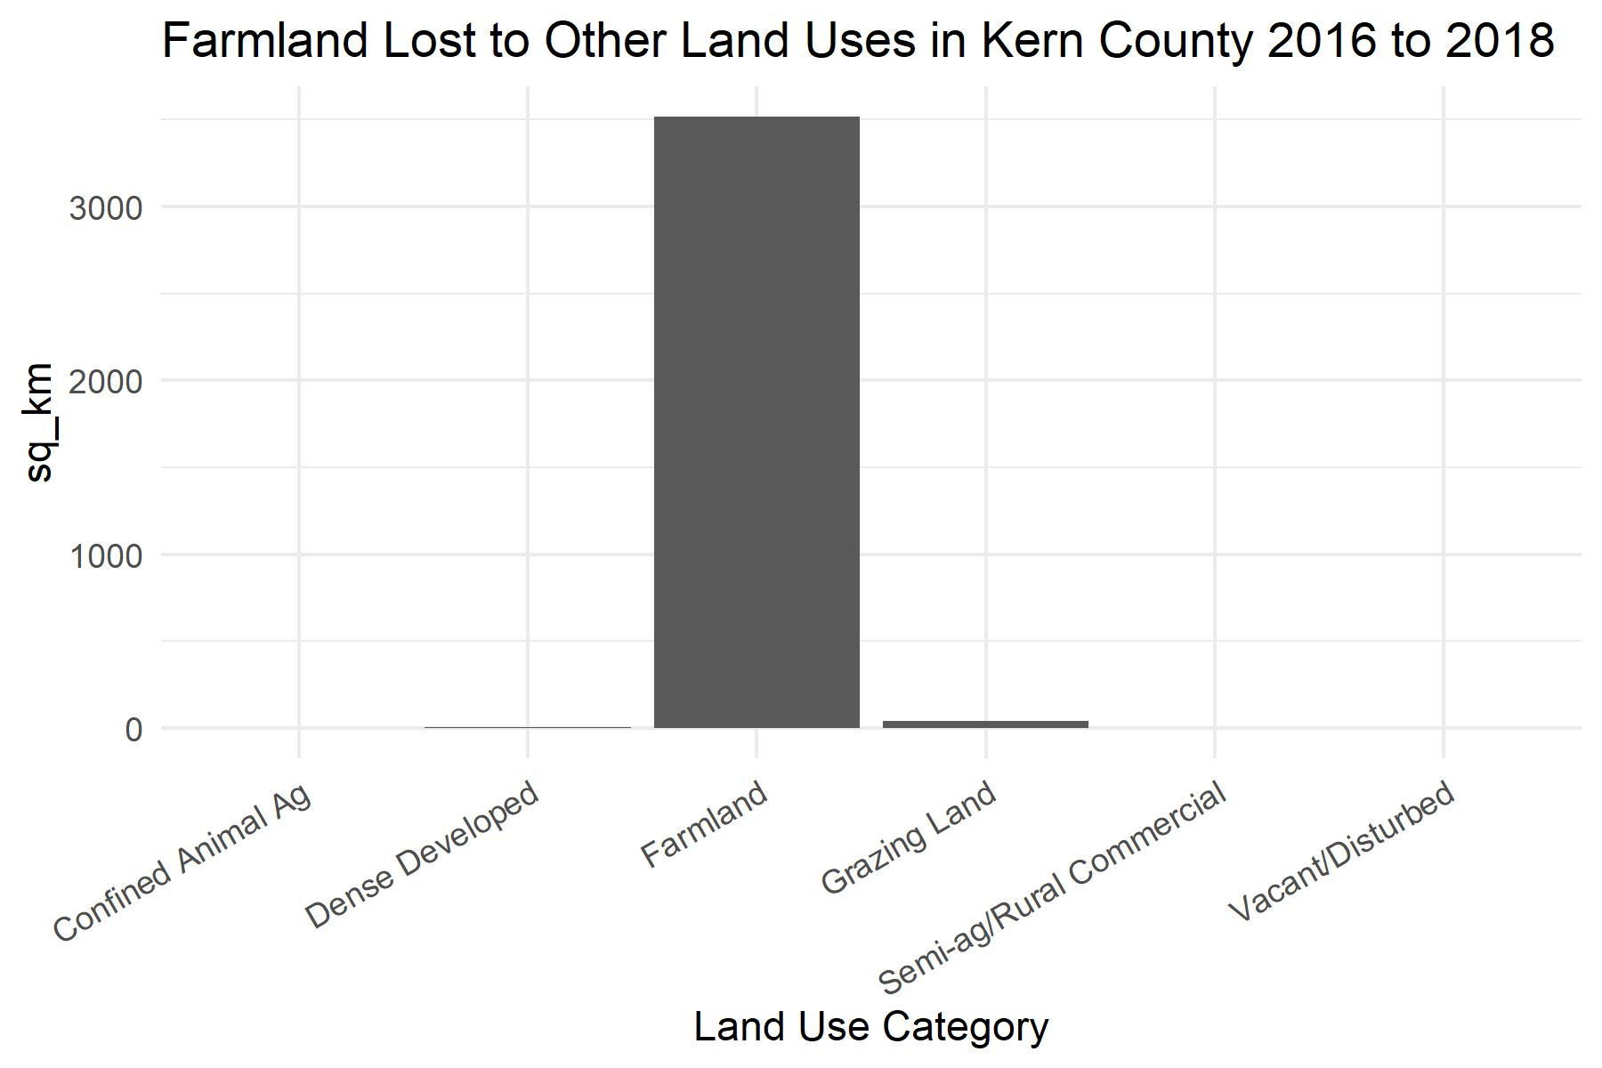
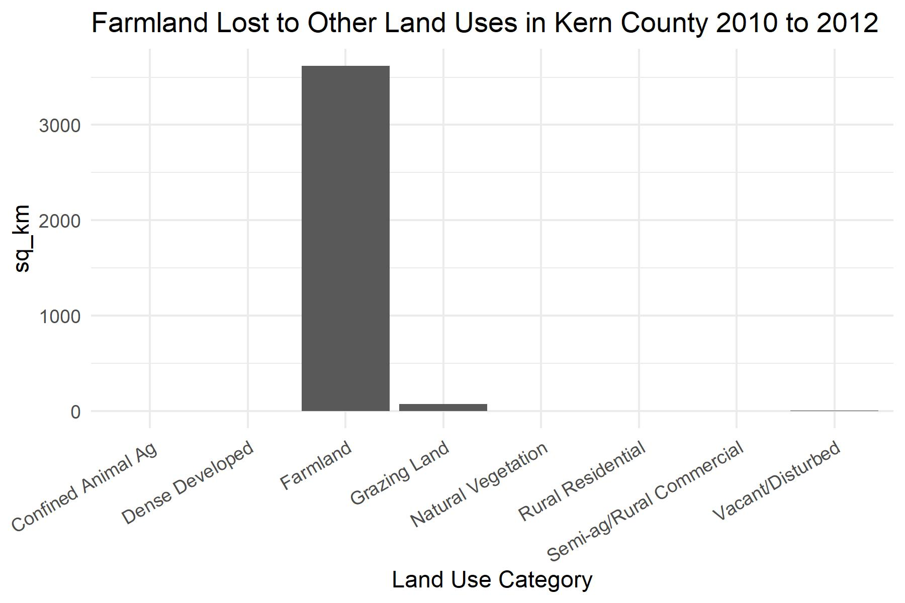
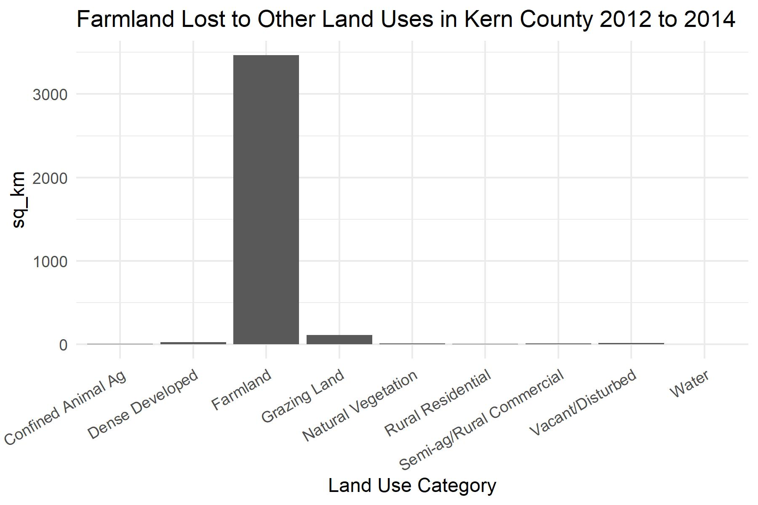
Results
Overall, farmland loss to other land uses was scattered and sparse
Most farmland lost was converted to grazing land

Slide 9
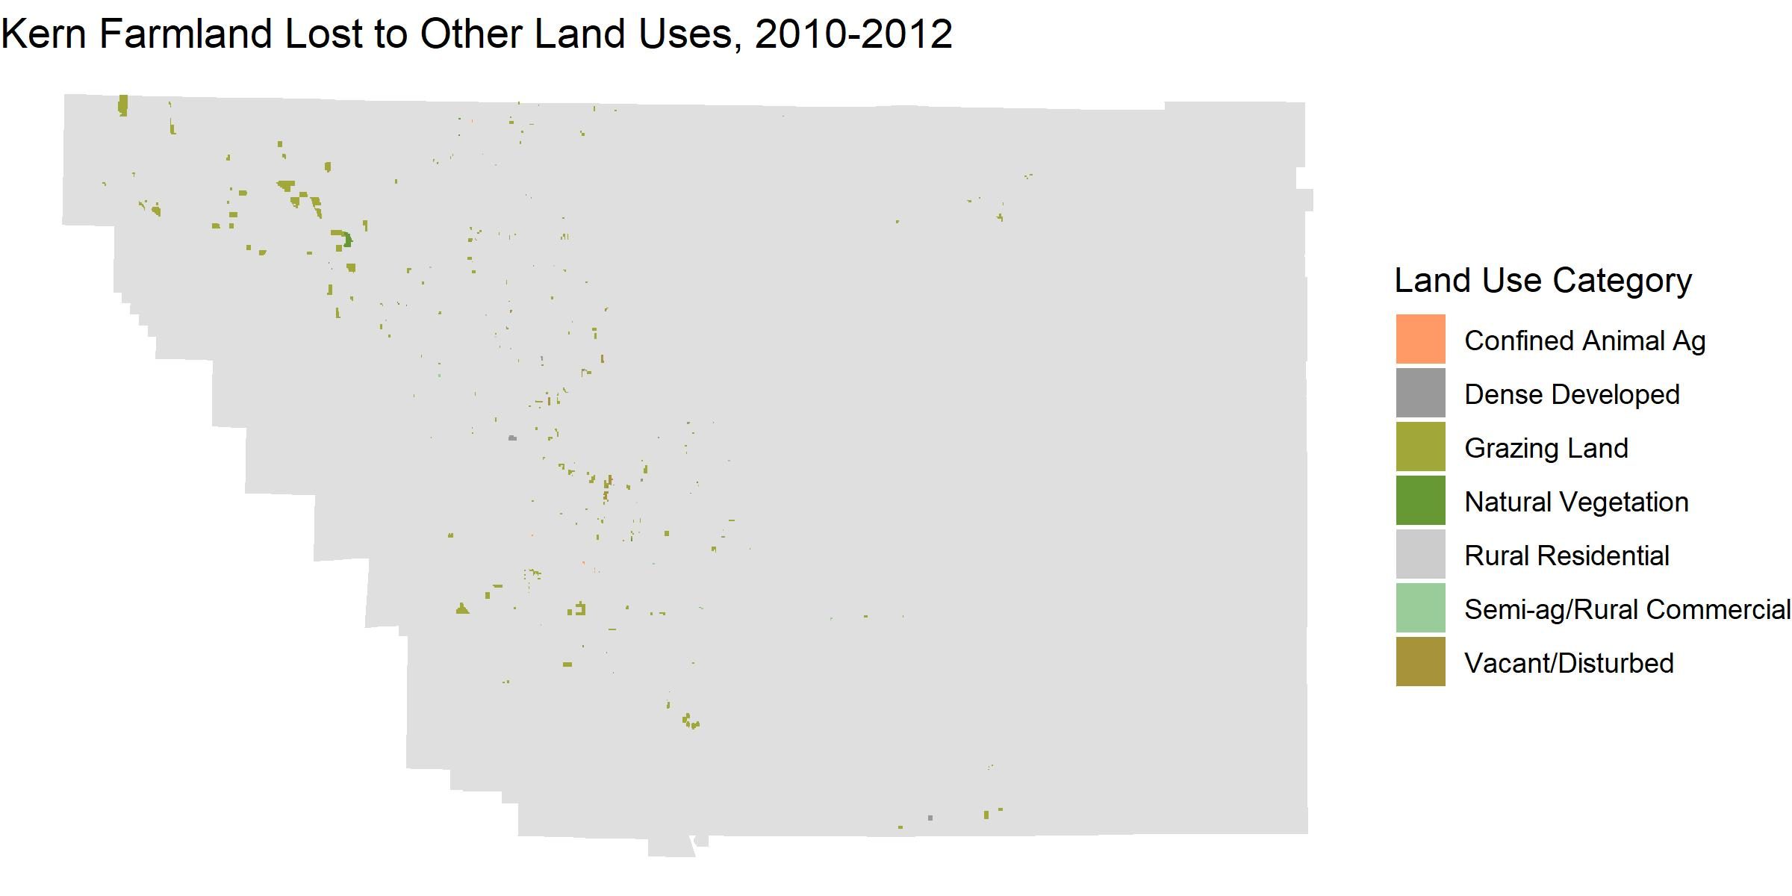

Slide 10
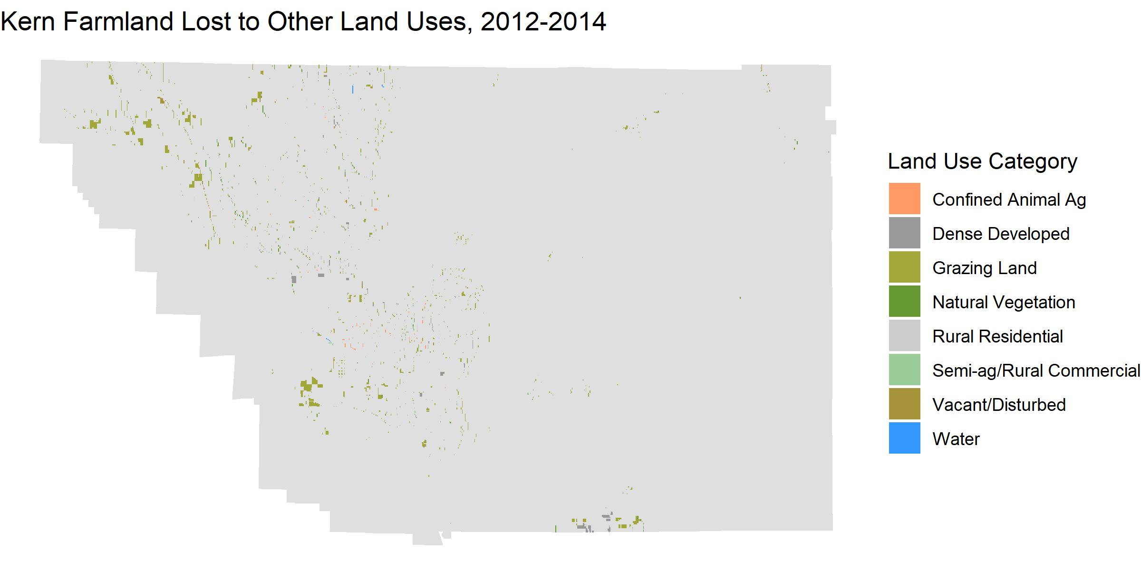

Slide 11
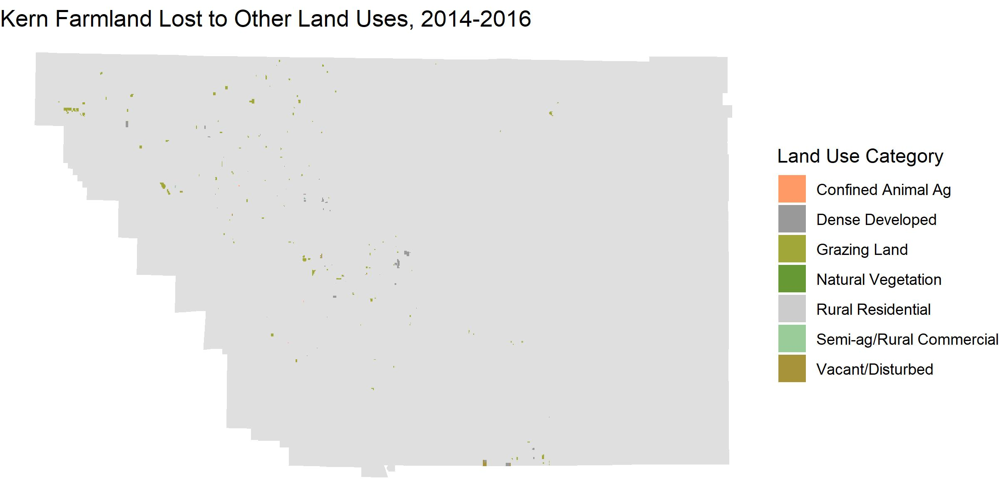

Slide 12
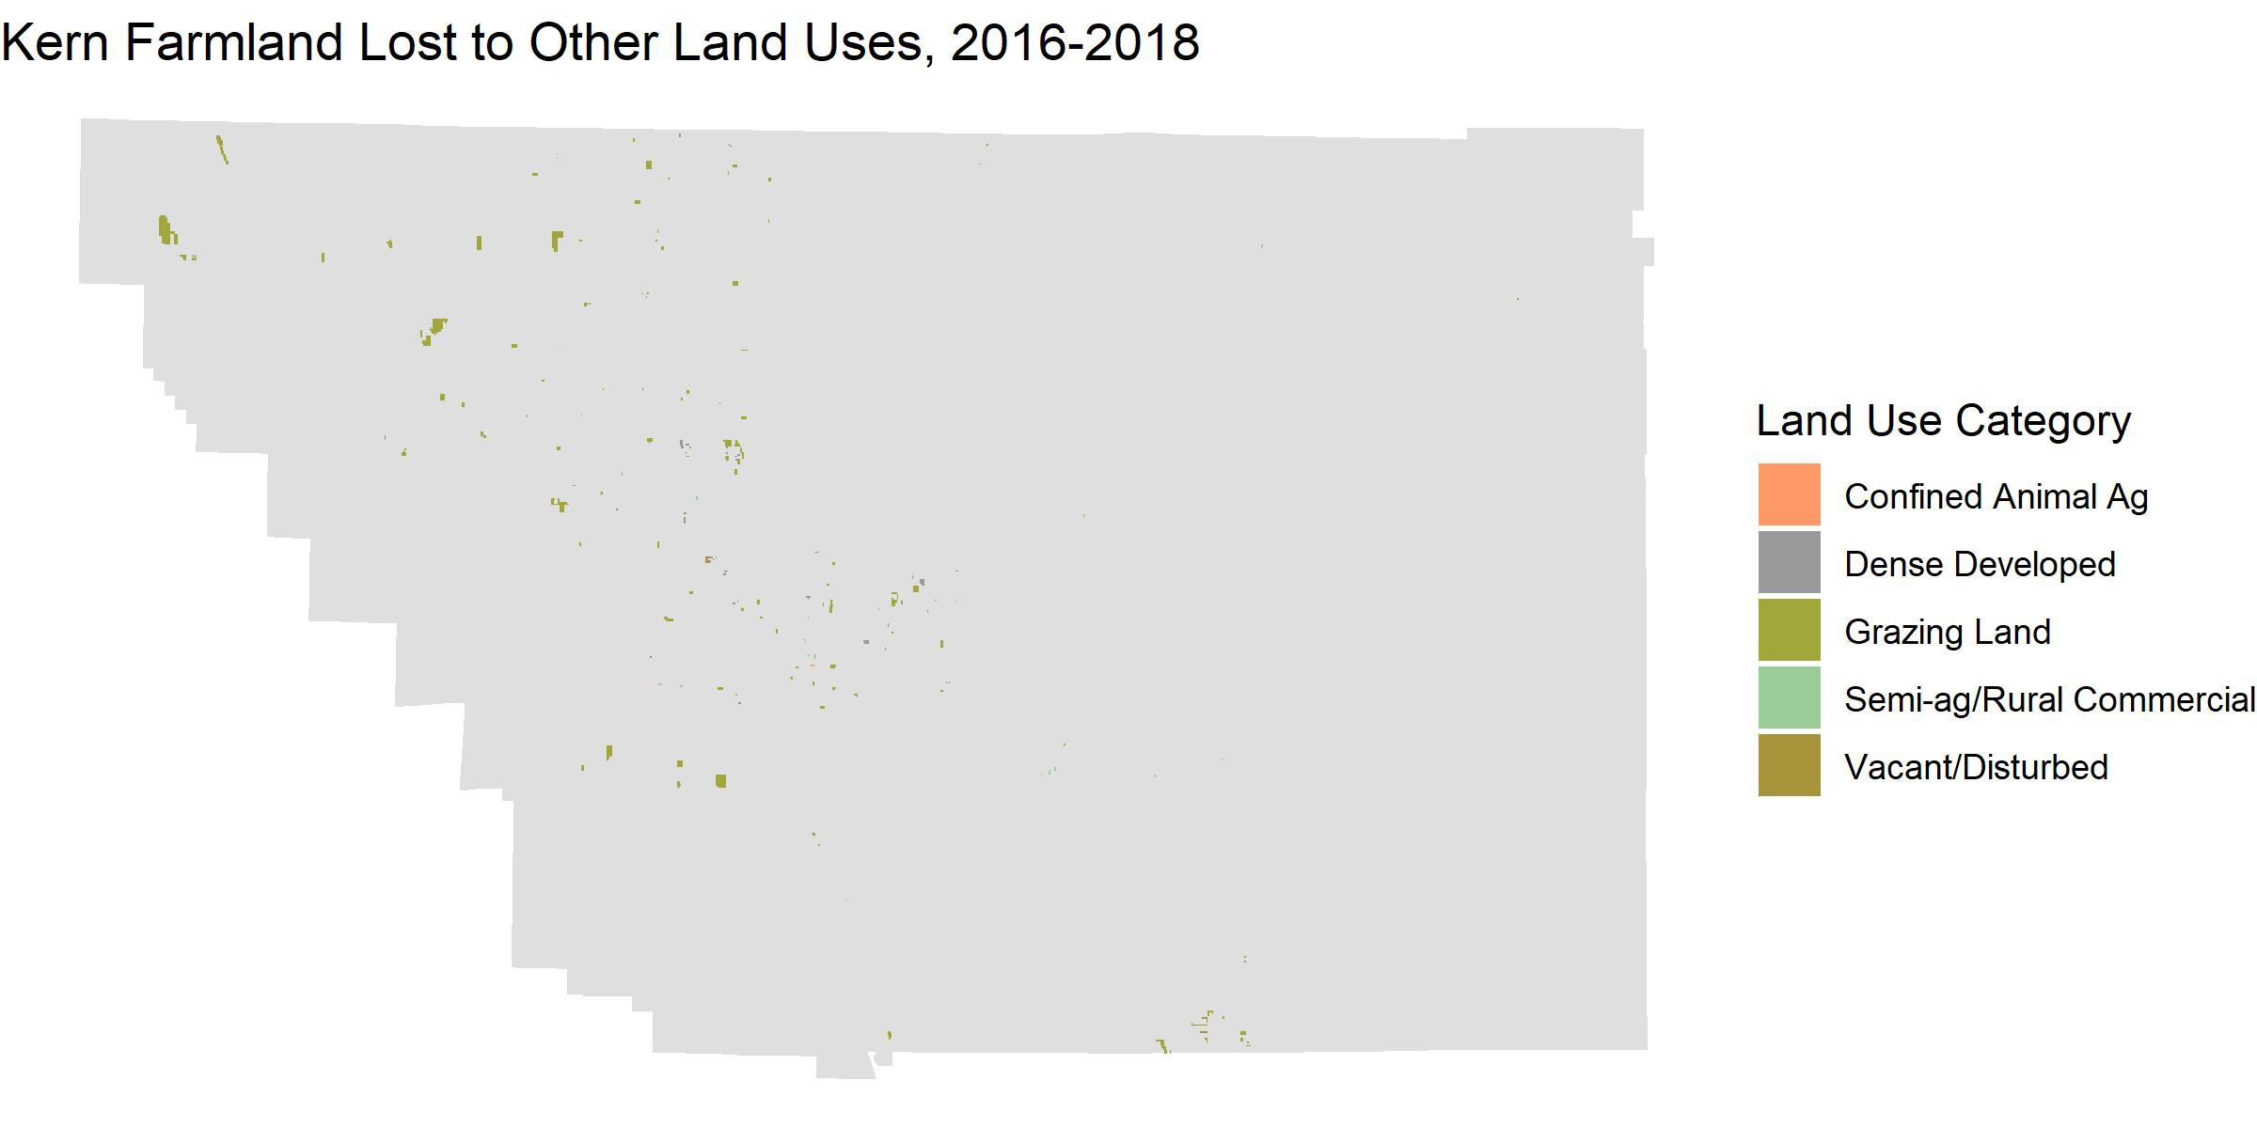

Slide 13
Limitations
Unable to use high-resolution data (e.g. LandSat, MODIS) due to unwieldy dataset size
My own knowledge of land use change analysis and raster manipulation
Self-taught methods over the semester
I still have a ways to go!

Slide 14
Next Steps
Assess other years for land use change patterns
2-year changes, 2000 through 2010
Calculate areas of clustered cells for each 2-year change
Future projects may use this workflow to look at land use change in other counties for associations with risk of valley fever

Slide 15
Thank you! Questions?
Many thanks to:
Jennifer Head
Justin Remais
Alex Heaney
Sam Maurer

